Slide 1

CEF440
DESIGN AND IMPLEMENTATION OF A MOBILE APP FOR COLLECTION OF USER EXPERIENCE DATA FROM MOBILE NETWORK SUBSCRIBERS
Project
CEF440 - Internet and Mobile Programming | Software Engineering Option
GROUP 5
2026
Academic Year

Slide 2
Presentation Outline
Background, Context & Survey Findings
System Modelling & Database Design
Technical QoS & QoE Metrics
Mobile App UI & Admin Dashboard
Backend API, Evaluation & Recommendations
06
07
08
09
10
Introduction, Problem & Objectives
Literature & Technology Stack
Requirements & System Design
Implementation & Measurement
Results, Conclusion & Future Work
01
02
03
04
05

Slide 3




01
02
03
04
PROBLEM
STATEMENT
GENERAL
OBJECTIVE
RESEARCH
QUESTION 1
RESEARCH
QUESTIONS 2–3
Mobile network operators lack real-time, subscriber-level Quality of Experience (QoE) data. Existing tools measure network-side QoS but fail to capture the actual user experience, leaving a critical gap in network optimization and subscriber satisfaction.
To design and implement a cross-platform mobile application that collects, stores, and transmits objective QoS metrics and subjective QoE feedback from mobile network subscribers to support network analysis and improvement.
How can a mobile application effectively collect both objective QoS metrics (latency, jitter, packet loss, download/upload speed) and subjective QoE ratings from mobile network subscribers in real time?
How can collected data be stored locally for offline use and synchronized to a cloud database for admin analysis? How can a heatmap and dashboard enable operators to identify network problem zones geospatially?
Core Focus
This page defines the foundation of the KILObYTES project: the gap between network-side QoS and user-perceived QoE, the app's core purpose, and the three research questions guiding design and implementation decisions throughout the project.

Slide 4
05
Scope, Significance & Methodology
HOW THE PROJECT IS STRUCTURED, WHY IT MATTERS, AND HOW WE BUILT IT
01
02
03
04
PROJECT SCOPE
SIGNIFICANCE
METHODOLOGY
KEY OUTCOMES
Mobile client app, admin web interface, backend REST API, SQLite local DB & MongoDB cloud DB
Benefits network operators, researchers, regulators & end users with real-time QoE insights
Cross-platform app, offline-first storage, heatmap visualization & bilingual support
6-step flow: Gather → Analyze → Model → Design → Implement → Test

Slide 5
07
Technology Stack
THE FINAL SELECTION — TOOLS & FRAMEWORKS POWERING KILOBYTES
01
02
03
04
FRONTEND
BACKEND
DATABASE
KEY APIS
React Native · Expo · JavaScript · Expo Location API · Expo Background Task
Node.js · Express.js · JWT Auth · bcryptjs · RESTful API Design
SQLite (local offline-first) · MongoDB + Mongoose (cloud analytics)
AsyncStorage · Expo Location · Background Fetch · Geospatial 2dsphere Index

Slide 6
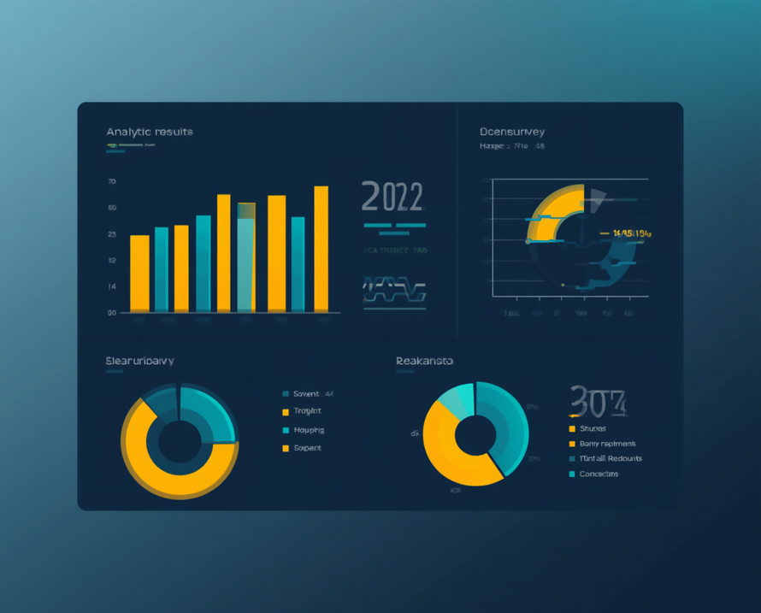
08
Survey
Findings
KEY INSIGHTS FROM SUBSCRIBER SURVEY DATA
49.1% of respondents prefer English as their app language, while 50.9% prefer French, highlighting the need for bilingual support.
Top reported network issues:
• Slow download/upload speed
• Weak or unstable signal
• Frequent connectivity drops
• High latency during peak hours
Privacy concerns: 68% of users expressed willingness to share anonymous network data. Only 14% had strong privacy objections, confirming broad acceptance of data collection with proper consent mechanisms in place.
75.9%
Android users among surveyed subscribers

Slide 7


09
Functional & Non-Functional Requirements
SYSTEM REQUIREMENTS SPECIFICATION
FUNCTIONAL REQUIREMENTS
✔ User registration & authentication
✔ Automated QoS data collection
✔ Local SQLite offline storage
✔ Cloud data upload & sync
✔ Heatmap visualization
✔ Admin filters & dashboard
✔ Bilingual (EN/FR) support
NON-FUNCTIONAL REQUIREMENTS
★ Security & data privacy (JWT, bcrypt)
★ Offline-first capability
★ Battery & data efficiency
★ Scalability & maintainability
★ Responsiveness across devices
★ High performance & reliability

Slide 8
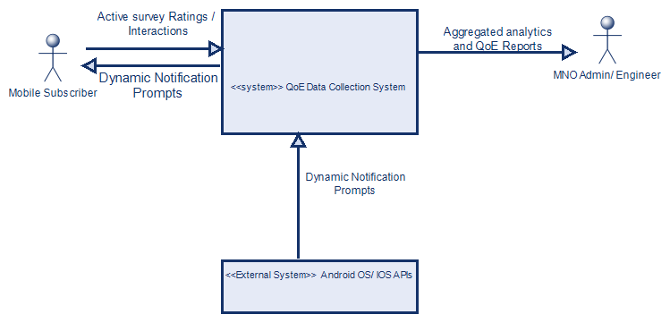
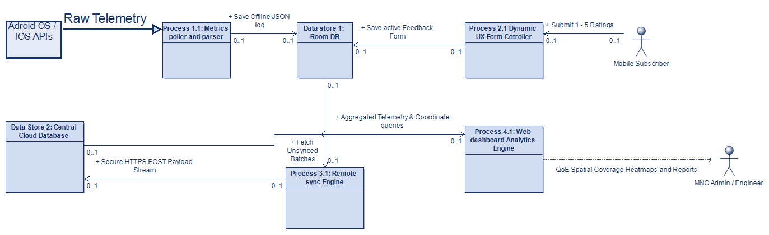
10
System Modelling Overview
SYSTEM ARCHITECTURE & DIAGRAM OVERVIEW
Three core diagrams define the system architecture of the KILObYTES mobile app:
📌 Context Diagram — Illustrates the system boundary and how the mobile app interacts with external entities: subscribers, network infrastructure, the admin dashboard, and the cloud backend.
🔄 Data Flow Diagram (DFD) — Traces the movement of measurement data from collection on the mobile client, through local SQLite storage, to upload via the REST API, and final storage in MongoDB for admin analysis.
👤 Use Case Diagram — Captures the functional interactions between two primary actors (Subscriber and Admin) and the system, covering registration, data collection, heatmap viewing, background consent, and admin filtering.

Slide 9
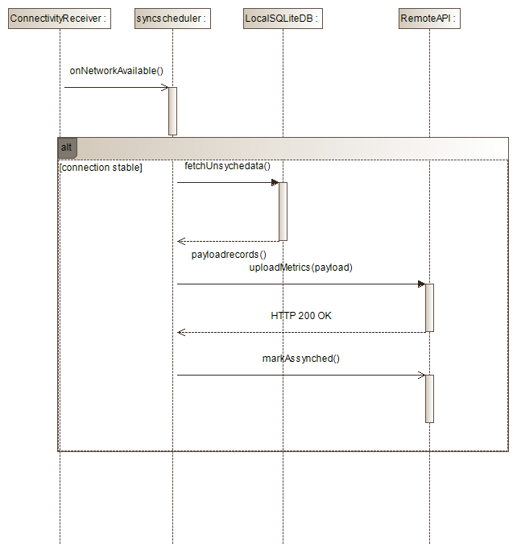
11
Sequence & Class Diagrams
11
SYSTEM INTERACTION & STRUCTURE MODELS
The Sequence Diagram illustrates the measurement upload flow between the mobile client, local SQLite database, and cloud backend. The Class Diagram defines the core object model with key relationships and responsibilities across all system components.

Slide 10
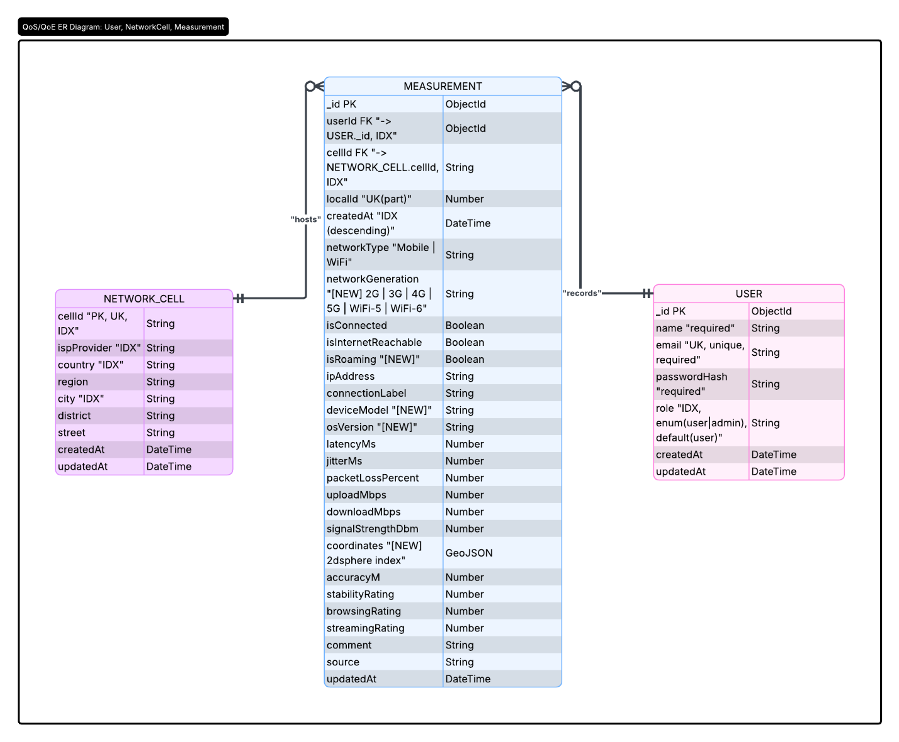

12
Database Design - ERD
THREE CORE ENTITIES AND THEIR RELATIONSHIPS
The database schema is built around three main entities: User (stores account credentials and profile data), Measurement (captures QoS/QoE metrics per session), and NetworkCell (records geospatial and network cell data). Relationships are one-to-many: one User can have many Measurements, and each Measurement is linked to one NetworkCell entry. Geospatial fields (latitude, longitude) use 2dsphere indexing in MongoDB for heatmap queries, while SQLite mirrors the schema locally for offline-first sync.

Slide 11
13
01
Latency (Ping)
How We Measure: Technical QoS Metrics
Multiple ICMP probes sent per session; average round-trip time recorded in milliseconds (ms).
02
Jitter
Standard deviation of successive latency samples; higher jitter indicates unstable network conditions (ms).
CORE NETWORK PERFORMANCE INDICATORS COLLECTED PER MEASUREMENT SESSION
03
Packet Loss
Calculated as: (Failed Probes ÷ Total Probes) × 100%. Indicates link reliability and congestion level.
Each measurement session captures four key QoS indicators using automated probing techniques. Latency is measured via multiple ICMP ping probes with the average response time recorded in milliseconds. Jitter quantifies network instability as the standard deviation of successive latency values. Packet Loss is computed as the ratio of failed probes to total probes, expressed as a percentage. Download and Upload Speed are derived by dividing the transferred file size by elapsed time, reported in Mbps. Together, these metrics provide an objective, reproducible snapshot of the subscriber's real-time network quality, enabling meaningful comparisons across locations, times, and operators.
04
Download / Upload Speed
File size divided by transfer time; both directions measured independently and reported in Mbps.

Slide 12

How We Measure: Subjective QoE & Environmental Data
ENVIRONMENTAL DATA
1–5
01
Streaming Quality
★★★★☆ Rate the quality of video and audio streaming (1 = very poor, 5 = excellent quality).
STAR RATING SCALE
AUTOMATICALLY CAPTURED
02
📅 Timestamp — Date and time of each measurement session recorded automatically.
📶 Network Type — Detects current connection: WiFi, 4G LTE, 3G, or 2G.
🔗 Connection Status — Online or offline state at time of data collection.
SUBJECTIVE FEEDBACK
Users rate their experience on a 1–5 star scale across three key dimensions of network quality.
LOCATION & IDENTITY
🌐 IP Address — Captured to identify network session and provider context.
🏢 ISP / Provider — Identifies the subscriber's network operator automatically.
📍 GPS Location — Precise coordinates via Expo Location API for geospatial mapping.
🗺️ Reverse Geocoding — Converts GPS coordinates into human-readable address details.
SIGNAL STABILITY
★★★★☆ Rate how stable your signal remains during use (1 = very unstable, 5 = perfectly stable).
14
BROWSING SPEED
★★★★☆ Rate how fast pages and content load during browsing (1 = very slow, 5 = very fast).

Slide 13


15
Local Storage
(SQLite)
SQLite
OFFLINE-FIRST ARCHITECTURE & SCHEMA DESIGN
LOCAL DB ENGINE
SQLite was chosen as the local database engine to support an offline-first approach. It stores measurement data directly on the device, ensuring the app functions reliably even without internet connectivity. Data is synced to the cloud once a connection is restored, using the "uploaded" flag to track sync status.
id — Unique record identifier
localId — Device-side local reference
latitude / longitude — GPS coordinates
latency — Measured ping in ms
downloadSpeed — Speed in Mbps
signalStability — User rating (1–5)
uploaded — Sync flag (0 = pending, 1 = synced)

Slide 14

16
Cloud Database
(MongoDB)
ANALYTICS & ADMIN ACCESS – WHY MONGODB?
MongoDB powers the cloud layer of KILObYTES, offering key advantages for network data analytics:
● Flexible Schema – Easily adapts to evolving measurement fields without migrations
● Geospatial Support – Native 2dsphere index enables location-based heatmap queries
● Scalable – Handles large volumes of subscriber measurement documents efficiently
● JSON-like Documents – Seamless integration with Node.js/Express.js backend
Collections: User · Measurement · NetworkCell
Key fields: qualityCategory, 2dsphere index, uploaded flag for sync

Slide 15
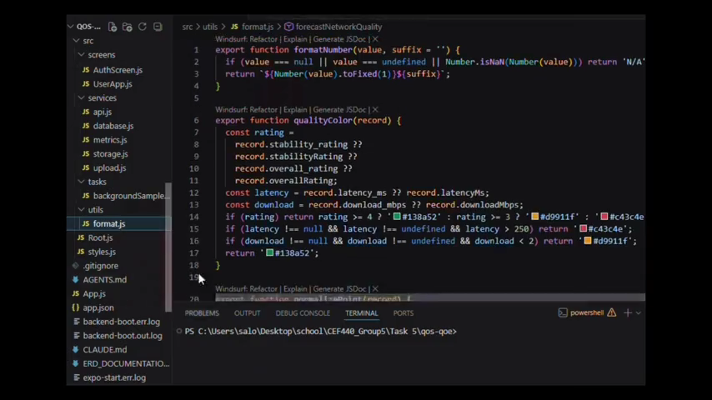
17
App UI
KILOBYTES IN ACTION – APP SCREEN WALKTHROUGH
Auth Screen – Secure login and registration with bilingual support and consent flow.
Collect Screen – Dashboard to trigger QoS measurements and view real-time metrics.
Heatmap Screen – Geospatial visualization of network quality across locations.
Settings & Consent – Manage background data collection permissions and preferences.

Slide 16
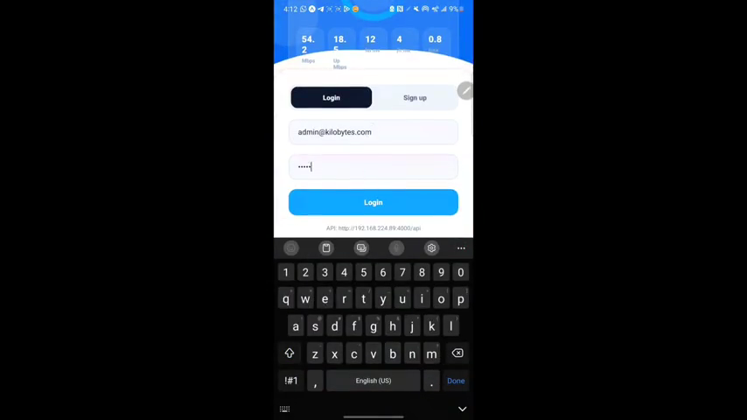
17
Admin UI
SCREEN WALKTHROUGH
Subscriber Records: Expandable cards showing per-user measurement history with timestamps and QoS scores
Metrics overview with filters by date, region, network type, and subscriber segment
Amin heatmap: Geospatial heatmap visualizing signal quality and latency hotspots across regions
Data management: Bulk export, sync status tracking, and uploaded flag monitoring for offline records

Slide 17

20
Evaluation
STRENGTHS & LIMITATIONS OF THE KILOBYTES APPLICATION
✅ STRENGTHS: Cross-platform (Android & iOS), offline-first architecture, privacy-by-design consent model, and comprehensive QoS + QoE data collection.
✅ Geospatial heatmap visualization, bilingual support (English & French), scalable cloud backend, and secure JWT-based authentication.
⚠️ LIMITATIONS: Signal strength data unavailable via Expo APIs; SIM card detection and network generation (3G/4G/5G) not fully implemented.
⚠️ Field naming inconsistencies in early data models; app requires production deployment configuration and further real-world field testing.

Slide 18

21
Conclusion & Recommendations
✓
PROJECT SUMMARY & FUTURE DIRECTIONS
KILOBYTES APP DELIVERED
Conduct real-world field testing across diverse network environments
Integrate native modules for SIM detection & signal strength (dBm)
Deploy backend with HTTPS, rate limiting & production security
Build advanced admin dashboards with real-time analytics filters
Apply ML models to predict QoE from QoS measurements
Publish to Google Play Store & Apple App Store
Thank You — Questions Welcome

Slide 19


Thank You!
Questions &
Discussion
Group 5
CEF440
University of Buea
Faculty of Engineering & Technology
Dept. of Computer Engineering
CEF440 – Internet & Mobile Programming
Software Engineering Option
Academic Year 2023/2024

